Slide 1
ICS215 – Data Structures II Algorithms on Bit Manipulation

Slide 2
Bitwise Operators:
AND &
OR |
XOR ^
NOT ~
LEFT SHIFT << NOTE: A<<B == A*POW(2,B)
RIGHT SHIFT >> NOTE: A<<B == A/ POW(2,B)
(<< and >> is not applicable for negative operators)

Slide 3
Application of BIT Operators
Bit operations are used for the optimization of embedded systems.
The Exclusive-or operator can be used to confirm the integrity of a file, making sure it has not been corrupted, especially after it has been in transit.
Bitwise operations are used in Data encryption and compression.
Bits are used in the area of networking, framing the packets of numerous bits which are sent to another system generally through any type of serial interface.
Digital Image Processors use bitwise operations to enhance image pixels and to extract different sections of a microscopic image.

Slide 4
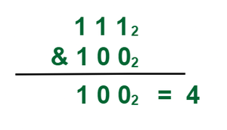
Bitwise AND Operator (&)
If the bits in the compared positions of the bit patterns are 1, then the resulting bit is 1. If not, it is 0.
Take two bit values X and Y, where
X = 7= (111)₂
Y = 4 = (100)₂ .
Take Bitwise and of both X & Y

Slide 5
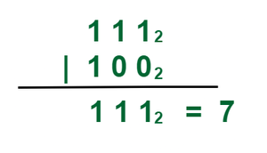
2. ​Bitwise OR Operator (|)
if the two bits in the looked-at position are 0, the next bit is zero. If not, it is 1.
Take two bit values X and Y, where
X = 7= (111)₂
Y = 4 = (100)₂ .
Take Bitwise OR of both X and Y

Slide 6
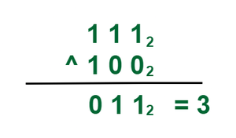
3. ​Bitwise XOR Operator (^)
if bits in the compared position do not match their resulting bit is 1, otherwise 0.
Take two bit values X and Y, where
X = 7= (111)₂
Y = 4 = (100)₂ .
Take Bitwise and of both X & Y

Slide 7
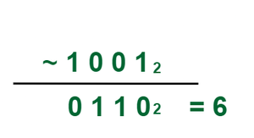
4. ​Bitwise NOT Operator (~)
this one requires only one operand to operate.
The bitwise Not Operator takes a single value and returns its one’s complement. The one’s complement of a binary number is obtained by toggling all bits in it, i.e, transforming the 0 bit to 1 and the 1 bit to 0
Take two bit values X and Y, where
X = 5= (101)₂ .
Take Bitwise NOT of X

Slide 8
5. Left-Shift (<<)
The general syntax for left shift is shift-expression << k. The left-shift operator causes the bits in shift expression to be shifted to the left by the number of positions specified by k. The bit positions that the shift operation has vacated are zero-filled.
Every time we shift a number towards the left by 1 bit it multiply that number by 2.
Input: Left shift of 5 by 1.
Output:?
Input: Left shift of 5 by 2.
Output:?
Input: Left shift of 5 by 3
Output?.

Slide 9
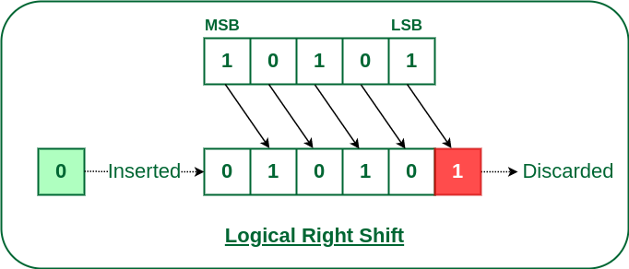
6. Right-Shift (>>)
The general syntax for the right shift is “shift-expression >> k”. The right-shift operator causes the bits in shift expression to be shifted to the right by the number of positions specified by k. The bit positions that the shift operation has vacated are zero-filled.
Input: right shift of 5 by 1.
Output:?
Input: right shift of 5 by 2.
Output:?
Input: right shift of 5 by 3
Output?.
Every time we shift a number towards the left by 1 bit it divide that number by 2

Slide 10
7. Compute the parity of a number using XOR and Table Look Up
Parity of a number refers to whether it contains an odd or even number of 1-bits. The number has “odd parity”, if it contains odd number of 1-bits and is “even parity” if it contains even number of 1-bits.
1 --> parity of the set is odd
0 --> parity of the set is even
Naïve Method
Algorithm: getParity(n)
1. Initialize parity = 0
2. Loop while n != 0
a. Invert parity
parity = !parity
b. Unset rightmost set bit
n = n & (n-1)
3. return parity

Slide 11
Example:
Initialize: n = 13 (1101) parity = 0
n = 13 & 12 = 12 (1100) parity = 1
n = 12 & 11 = 8 (1000) parity = 0
n = 8 & 7 = 0 (0000) parity = 1
Answer: ODD

Slide 12
Efficient Approach: XOR and Table Look up
we break a number S into two parts S₁ and S₂ such S = S₁S₂. If we know parity of S₁ and S₂, we can compute parity of S using below facts:
If S₁ and S₂ have the same parity, i.e. they both have an even number of bits or an odd number of bits, then their union S will have an even number of bits.
Therefore parity of S is XOR of parities of S₁ and S₂
The idea is to create a look up table to store parities of all 8 bit numbers. Then compute parity of whole number by dividing it into 8 bit numbers and using above facts.
Steps:
Create a look-up table for 8-bit numbers ( 0 to 255 )
Parity of 0 is 0.
Parity of 1 is 1
.
.
.
Parity of 255 is 0. and so on
2. Break the number into 8-bit chunks while performing XOR operations.
3. Check for the result in the table for the 8-bit number.

Slide 13
Take 32-bit number : 1742346774
2. Calculate Binary of the number : 01100111110110100001101000010110
3. Split the 32-bit binary representation into 16-bit chunks :
0110011111011010 | 0001101000010110
4. Compute X-OR :
0110011111011010
^ 0001101000010110
___________________
= 0111110111001100
5. Split the 16-bit binary representation into 8-bit chunks : 01111101 | 11001100
6. Again, Compute X-OR :
01111101
^ 11001100
___________________
= 10110001
10110001 is 177 in decimal. Check for its parity in look-up table :
Even number of 1 = Even parity.
Thus, Parity of 1742346774 is even.

Slide 14
Brian Kernighan’s Algorithm to count set bits in an integer
To count the number of 1s in the binary representation of an integer.
Examples :
Input : n = 6
Output: 2
The binary representation of 6 is 110 and has 2 set bits
Input : n = 13
Output : 3
The binary representation of 13 is 1101 and has 3 set bits

Slide 15
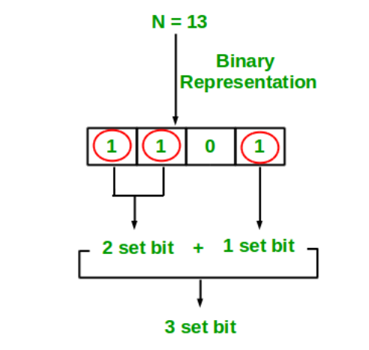
Simple Method
Loop through all bits in an integer, check if a bit is set (n&1)and if it is, then increment the set bit count, n>>=1.
Complexity :O(n)
n is the number of bits

Slide 16
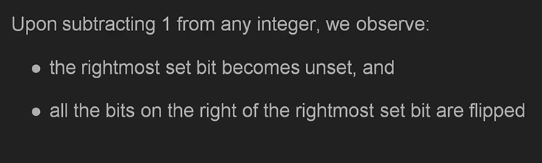
Brian Kernighan’s Algorithm:
Subtracting 1 from a decimal number flips all the bits after the rightmost set bit(which is 1) including the rightmost set bit.
For example
binary representation of 9 is 00001001
binary representation of 8 is 00001000
binary representation of 7 is 00000111
binary representation of 6 is 00000110

Slide 17
Brian Kernighan’s Algorithm:
Steps:
1 Initialize count: = 0
2 If integer n is not zero
(a) Do bitwise & with (n-1) and assign the value back to n
n: = n&(n-1)
(b) Increment count by 1
(c) go to step 2
3 Else return count
Complexity :O(log n)
n is the number of bits

Slide 18
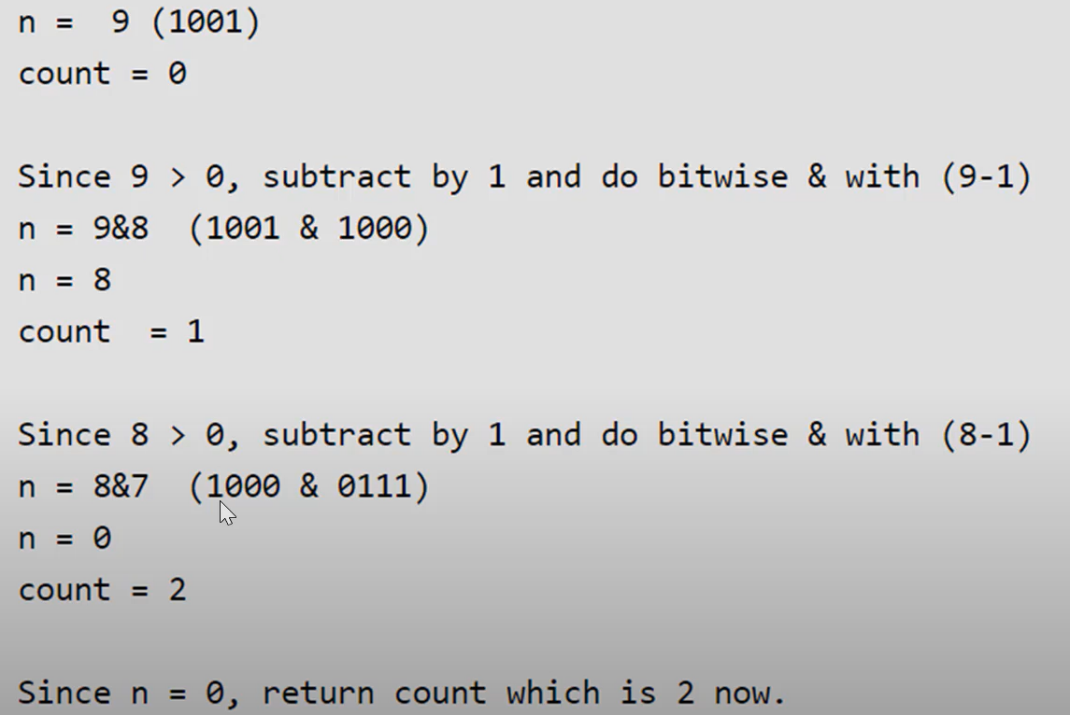
Brian Kernighan’s Algorithm:

Slide 19
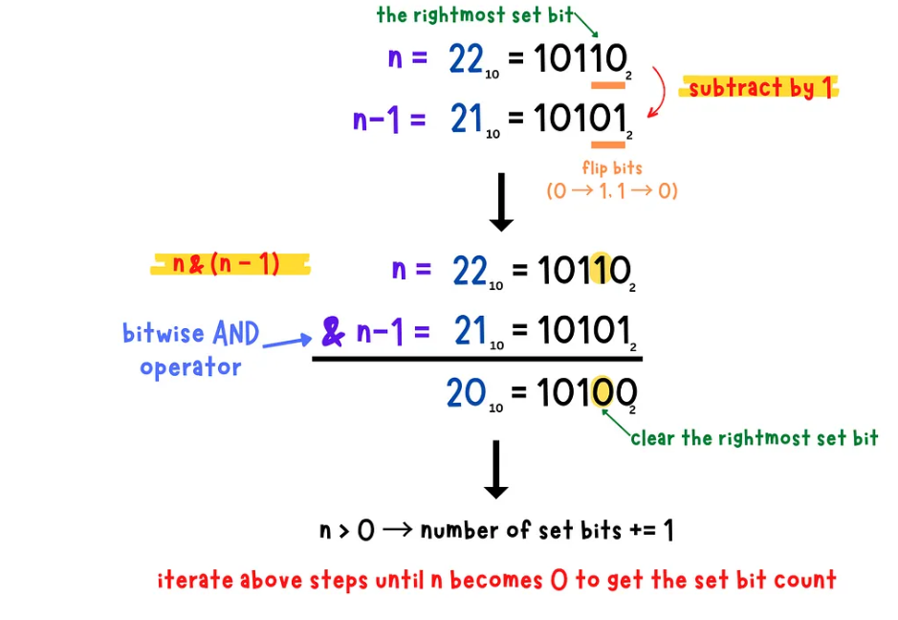
use n & (n-1) expression to clear the rightmost set bit of n until n becomes zero.
The number of times we clear the rightmost set bit of n will be the set bit count.

Slide 20
Practice Problems on Bitwise Algorithm
1. How to Set a bit in the number?
If we want to set a bit at nth position in the number ‘num’, it can be done using the ‘OR’ operator( | ).
First, we left shift 1 to n position via (1<<n)
Then, use the “OR” operator to set the bit at that position. “OR” operator is used because it will set the bit even if the bit is unset previously in the binary representation of the number ‘num’.

Slide 21
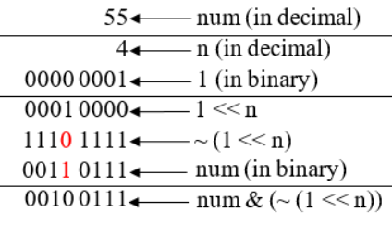
2. How to unset/clear a bit at n’th position in the number
Suppose we want to unset a bit at nth position in number ‘num’ then we have to do this with the help of “AND” (&) operator.
First, we left shift ‘1’ to n position via (1<<n) then we use bitwise NOT operator ‘~’ to unset this shifted ‘1’.
Now after clearing this left shifted ‘1’ i.e making it to ‘0’ we will ‘AND'(&) with the number ‘num’ that will unset bit at nth position.

Slide 22
3. Toggling a bit at nth position
Toggling means to turn bit ‘on'(1) if it was ‘off'(0) and to turn ‘off'(0) if it was ‘on'(1) previously. We will be using the ‘XOR’ operator here which is this ‘^’.
If two bits are different then the ‘XOR’ operator returns a set bit(1) else it returns an unset bit(0).

Slide 23
4. Checking if the bit at nth position is Set or Unset
We used the left shift (<<) operation on 1 to shift the bits to nth position and then use the & operation with number given number, and check if it is not-equals to 0.

Slide 24
Multiply a number by 2 using the left shift operator
6. Divide a number 2 using the right shift operator
7. Count Set bits in an integer
8. Position of rightmost set bit

